Slide 1
Implementation of Timer using 8051
Engr. Shahzada Fahim Jan

Slide 2
Timers:
8051 has two timers/counters, They can be used either as
Timer to generate a timer delay
Event counter to count events happening outside the microcontroller
Both timer 0 and timer 1 are 16 bit wide
Since 8051 has 8-bit architecture, each 16 bit timer is accessed as two separate registers of low byte and high byte

Slide 3
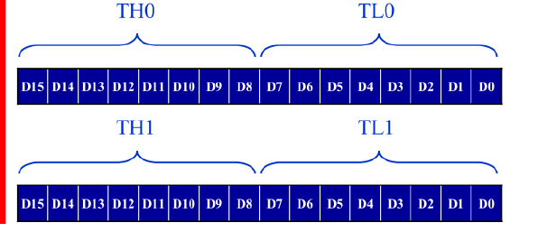
Accessed as low byte and high byte
Low byte register is called TL0/TL1
High byte register is called TH0/TH1

Slide 4
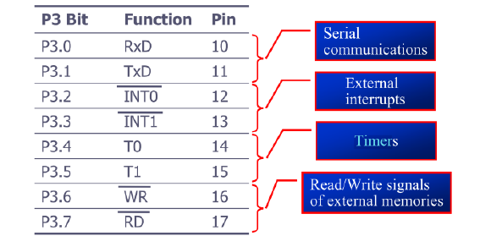
PORT 3 can be used as input or output
PORT 3 does not need any Pull-up resistor
PORT 3 has additional function of providing some extremely important signals

Slide 5
TMOD (timer mode) register
Both timer 0 and timer 1 use the same register, called TMOD to set the various timer operation modes.
TMOD is an 8-bit register in which the lower 4 bits are set aside for Timer 0 and the upper 4 bits for Timer 1.
In each case the lower 2 bits are used to set the timer mode and the upper 2 bits to specify the operation.

Slide 6
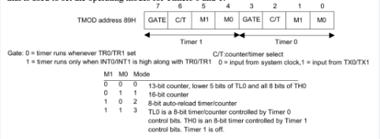

Slide 7
M1,M0
M0 and M1 select the timer mode.
There are three modes 0, 1 and 2
Mode 0 is a 13-bit timer
Mode 1 is a 16-bit timer
Mode 2 is an 8-bit timer
We will focus on Mode 1 and Mode 2 since they are the ones used most widely

Slide 8
C/T(clock/timer)
This bit in the TMOD register is used to decide whether the timer is used as a delay generator or an event counter. If C/T=0, it is used as a timer for time delay generation

Slide 9
Mode 1 programming
Characteristics and operations of mode 1
It is a 16-bit timer, therefore, it allows values of 0000 to FFFFH to be loaded into the timers register TL and TH.
After TH and TL are loaded with a 16-bit initial value, the timer must be started. This is done by “SETB TR0” for timer 0 and “SETB TR1” for timer1.
After the timer is started, it start to count up. It counts up until it reaches its limit of FFFFH. When it rolls over from FFFFH to 0000, it sets high a flag bit called timer flag. This timer flag can be monitored.

Slide 10
When this timer flag is raised, one option would be to stop the timer with the instructions “CLR TR0” for timer 0 and “CLR TR1” for timer1.
After the timer reaches its limit and rolls over, in order to repeat the process the registers TH and TL must be reloaded with the original values, and TF must be reset to 0.

Slide 11
Time delay
To generate a time delay, Follow these steps
Load TMOD value register indicating which timer (timer 0 or timer 1) is to be used and which timer mode (0 or 1) is selected.
Load registers TL and TH with initial count values
Start the timer.
Keep monitoring the timer flag (TF) with go out of the loop when TF becomes high
Stop the timer.
Clear the TF flag for the next round
Go to step 2 to load TH and TL again

Slide 12
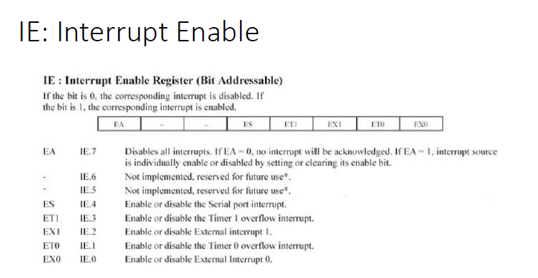
IE(Interrupt Enable)

Slide 13
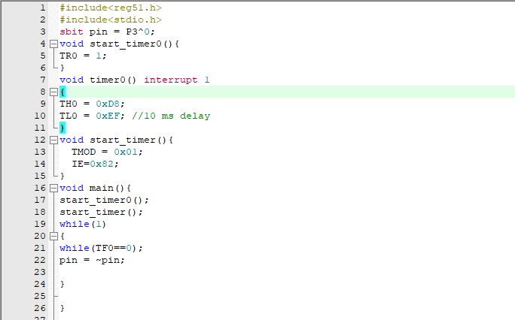
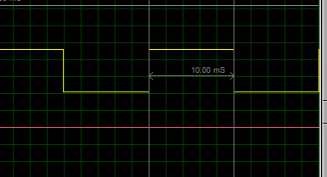

Slide 14
Tasks
Use timer to Generate a delay of 15ms
Use timer to Generate a delay of 50ms
Use timer to Generate a delay of 200ms
Use timer to Generate a delay of 200us

